Slide 1
Data Mining — Cluster Analysis —
*
Data Mining: Concepts and Techniques
‹#›

Slide 2
What is Cluster Analysis?
Cluster: a collection of data objects
Similar to one another within the same cluster
Dissimilar to the objects in other clusters
Cluster analysis
Finding similarities between data according to the characteristics found in the data and grouping similar data objects into clusters
Unsupervised learning: no predefined classes
*
‹#›

Slide 3
Clustering Applications
Business Intelligence: To organize a large no of customers into groups.
Image Pattern Recognition: handwritten character recognition systems to improve overall recognition accuracy using multiple models based on multiple subclasses/clusters.
Web Search: To organize the relevant web pages in a concise and easily accessible way.
Biology: It can be used for classification among different species of plants and animals.
Information Retrieval: cluster documents into topics
Marketing: It can be used to characterize & discover customer segments for marketing purposes.
*
‹#›

Slide 4
Examples of Clustering Applications
Libraries: It is used in clustering different books on the basis of topics and information.
Insurance: Identifying groups of motor insurance policy holders with a high average claim cost and identifying the frauds.
As a DM function, clustering can be used
As a stand-alone tool to get insight into data distribution
As a preprocessing step for other algorithms
Outlier detection
*
‹#›

Slide 5
Requirements of Clustering in Data Mining
Scalability:
Clustering on only a small sample of a large Dataset can lead to biased results.
Ability to deal with different types of attributes:
Recently many applications need clustering on complex data types like graph, sequences, images and documents.
Discovery of clusters with arbitrary shape
Clusters based on ED and MD are spherical in shape.
Requirements to provide domain knowledge in the form of input parameters:
Hard to determine.(high dimensionality DS and no deep understanding)
makes quality of the clustering difficult to control.
Clustering results are sensitive to those parameters.
*
Data Mining: Concepts and Techniques
‹#›

Slide 6
Requirements of Clustering in Data Mining
Able to deal with noisy data
Clustering algorithms are sensitive to noise and may produce low quality clusters.
Incremental clustering and insensitivity to input data order.
Incorporate incremental updates into existing clustering structures
Capability of clustering high-dimensional data
High dimensional data can be very sparse and highly skewed.
Incorporation of user-specified constraints
Clustering algorithms should be able to find clusters that satisfy the specified constraints.
Interpretability and usability
*
‹#›

Slide 7
Major Clustering Approaches
Partitioning approach:
Given a set of n objects, a partitioning method constructs k partitions of the data, where each partition represents a cluster and k <= n.
The basic partitioning methods typically adopt exclusive cluster separation
Most partitioning methods are distance-based.
Given k, this approach creates initial partitioning and then uses Iterative relocation technique to improve it.
The general criterion of a good partitioning is that objects in the same cluster are “close” or related to each other, whereas objects in different clusters are “far apart” or very different .
Typical methods: k-means, k-medoids, CLARANS
*
Data Mining: Concepts and Techniques
‹#›

Slide 8
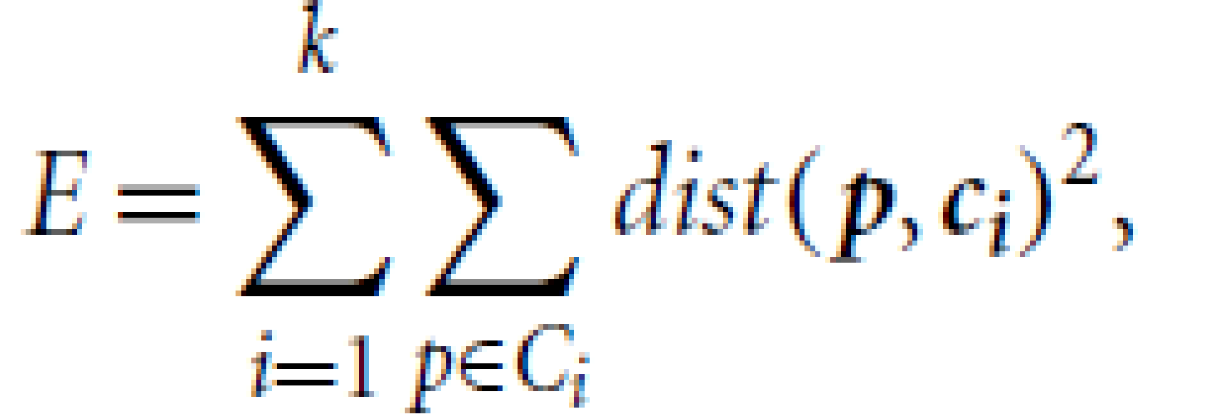
The K-Means Clustering Method
A centroid-based partitioning technique uses the centroid of a cluster, Ci , to represent that cluster.
The quality of cluster Ci can be measured by the within cluster variation, which is the sum of squared error between all objects in Ci and the centroid ci, defined as
where E is the sum of the squared error for all objects in the data set; p is the point in space representing a given object; and ci is the centroid of cluster Ci (both p and ci are multidimensional).
This objective function tries to make the resulting k clusters as compact and as separate as possible.
Optimizing the within-cluster variation is computationally challenging.
To overcome the prohibitive computational cost for the exact solution, greedy approaches are often used in practice. e.g k-means algorithm
*
‹#›

Slide 9
The K-Means Clustering Method
Given k, the k-means algorithm is implemented as below :
First, it randomly selects k of the objects in D, each of which initially represents a cluster mean or cluster center.
For each of the remaining objects, an object is assigned to the cluster to which it is the most similar, based on the Euclidean distance between the object and the cluster mean.
The k-means algorithm then iteratively improves the within-cluster variation.
For each cluster, it computes the new mean using the objects assigned to the cluster in the previous iteration.
All the objects are then reassigned using the updated means as the new cluster centers.
The iterations continue until the assignment is stable, that is, the clusters formed in the current round are the same as those formed in the previous round.
*
Data Mining: Concepts and Techniques
‹#›

Slide 10
The K-Means Clustering Method (5 steps)
Step 1: Choose the no.of clusters ,k.
Step2: Select at random k points, the centroids(not necessarily from your dataset)
Step3: Assign each data point to the closest centroid as that forms k clusters.
Step4: Compute and place new centroid of each cluster.
Step5: Reassign each data point to the new closest centroid . If any reassignment takes place go to step 4 . Otherwise (if the assignment is stable, i.e. the clusters formed in the current round are the same as those formed in the previous round) then STOP.
The process of iteratively re assigning objects to clusters to improve the partitioning is referred to as iterative relocation technique.
*
Data Mining: Concepts and Techniques
‹#›

Slide 11
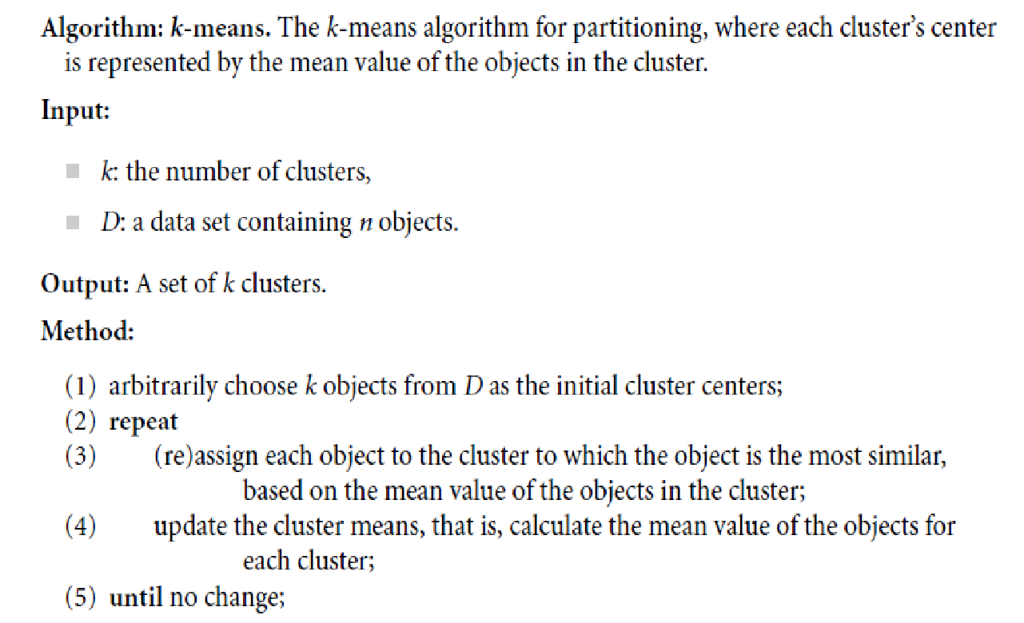
K- means Algorithm

Slide 12
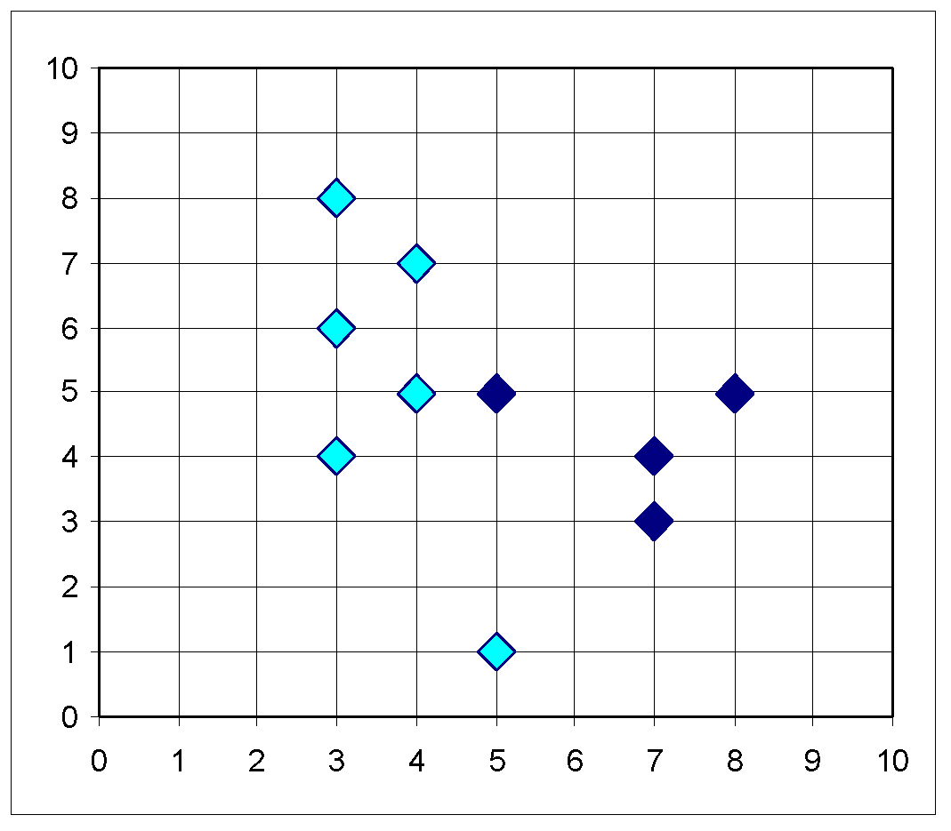
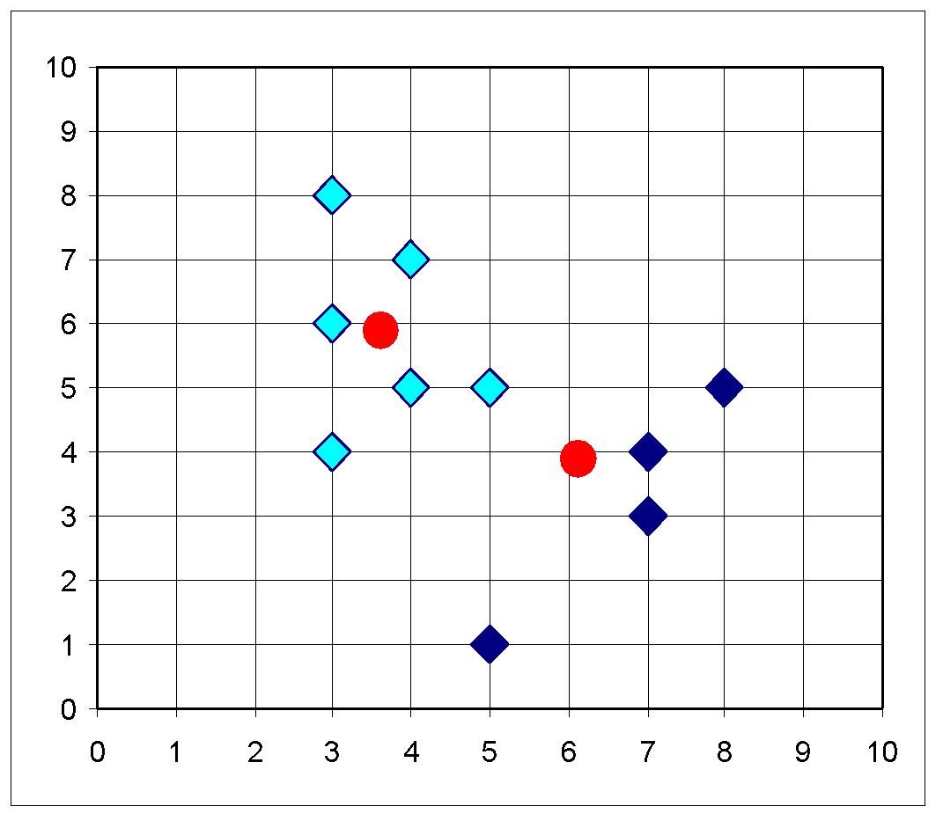
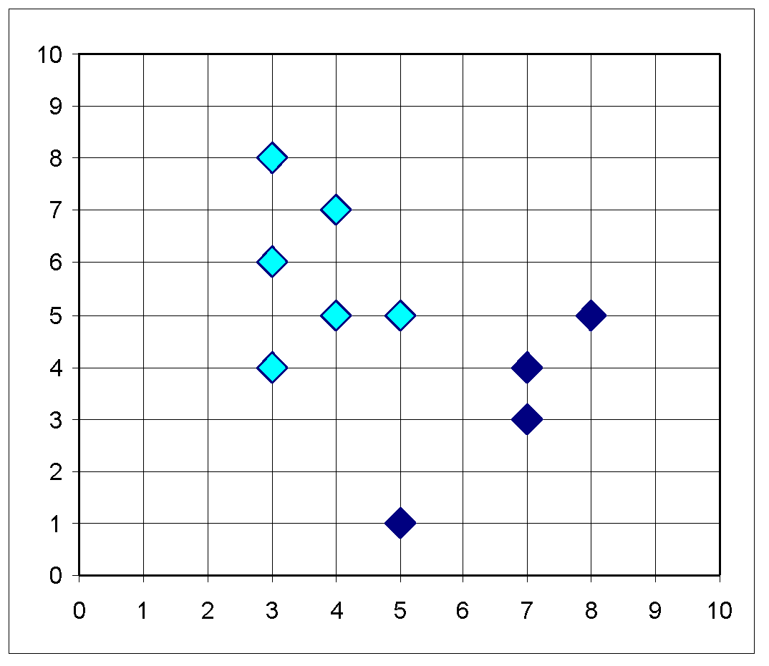
The K-Means Clustering Method
Example
10
10
9
9
8
8
7
7
6
6
5
5
4
Assign each objects to most similar center
Update the cluster means
4
3
3
2
2
1
1
0
0
0
1
2
3
4
5
6
7
8
9
10
0
1
2
3
4
5
6
7
8
9
10
reassign
reassign
K=2
Arbitrarily choose K object as initial cluster center
Update the cluster means
*
Data Mining: Concepts and Techniques
‹#›

Slide 13
Example
Suppose that the data mining task is to cluster points (with (x, y) representing location) into three clusters, where the points are A1(2, 10),A2(2, 5),A3(8, 4),B1(5, 8),B2(7, 5),B3(6, 4),C1(1, 2),C2(4, 9). The distance function is Euclidean distance. Suppose initially we assign A1, B1, and C1 as the center of each cluster, respectively. Use the k-means algorithm to show only
(a) the three cluster centers after the first round of execution.
(b) the final three clusters.

Slide 14
Solution
Suppose that the data mining task is to cluster points (with (x, y) representing location) into three clusters, where the points are A1(2, 10),A2(2, 5),A3(8, 4),B1(5, 8),B2(7, 5),B3(6, 4),C1(1, 2),C2(4, 9). The distance function is Euclidean distance. Suppose initially we assign A1, B1, and C1 as the center of each cluster, respectively. Use the k-means algorithm to show only
(a) the three cluster centers after the first round of execution.
Answer:
After the first round, the three new clusters are: (1) {A1}, (2) {B1,A3,B2,B3,C2}, (3) {C1,A2}, and their centers are (1) (2, 10), (2) (6, 6), (3) (1.5, 3.5).
(b) the final three clusters.
Answer:
The final three clusters are: (1) {A1,C2,B1}, (2) {A3,B2,B3}, (3) {C1,A2}.

Slide 15
Comments on the K-Means Method
Strength: Relatively efficient: O(nkt), where n is # objects, k is # clusters, and t is # iterations. Normally, k, t << n. Therefore, the method is relatively scalable and efficient in processing large data sets.
Weakness:
The k-means method is not guaranteed to converge to the global optimum and often terminates at a local optimum
The results may depend on the initial random selection of cluster centres.
Applicable only when mean is defined, then what about categorical data?
Need to specify k, the number of clusters, in advance.
Unable to handle noisy data and outliers
A small no. of such data can substantially influence the mean value.
Not suitable to discover clusters with non-convex shapes or clusters of very different size.
*
‹#›

Slide 16
Variations of K-Means Method
Handling categorical data: k-modes (Huang’98)
Pick K observations at random and use them as leaders/clusters
Calculate the dissimilarities and assign each observation to its closest cluster
Define new modes for the clusters
Repeat 2–3 steps until there are is no re-assignment required
Handling mixture of numeric and categorical data: k-prototype method
*
Data Mining: Concepts and Techniques
‹#›

Slide 17
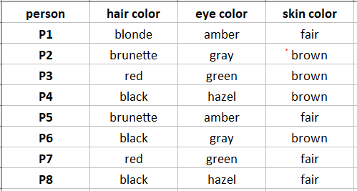
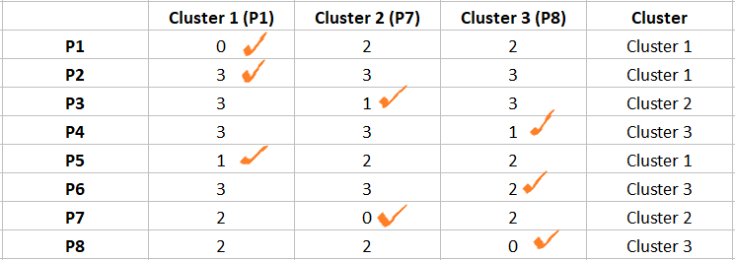
K-modes clustering Example
k=3.
Step 1: Lets select P1,P7 and P8 as leaders/cluster
Step2 : Calculate the dissimilarities(no. of mismatches) and assign each observation to its closest cluster
Comparing leader/Cluster P1 to the observation P1 gives 0 dissimilarities.
Comparing leader/cluster P1 to the observation P2 gives 3(1+1+1) dissimilarities.
Likewise, calculate all the dissimilarities and put them in a matrix as shown below and assign the observations to their closest cluster(cluster that has the least dissimilarity)

Slide 18
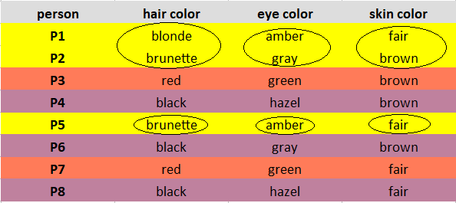
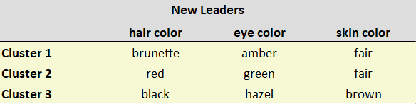
K-modes clustering Example(Cntd..)
Step 3: Define new modes for the clusters (Mode is simply the most observed value. )
Mark the observations according to the cluster they belong to. K1: Yellow, Brick Red: K2, Purple: K3
Considering one cluster at a time, for each feature, look for the Mode and update the new leaders
Cluster 1 observations(P1, P2, P5) has brunette as the most observed hair color, amber as the most observed eye color, and fair as the most observed skin color.
Note: If you observe the same occurrence of values, take the mode randomly. In our case, the observations of Cluster 2(P3, P7) have one occurrence of brown, fair skin color. I randomly chose fair as the mode.
.
Repeat steps 2–3

Slide 19
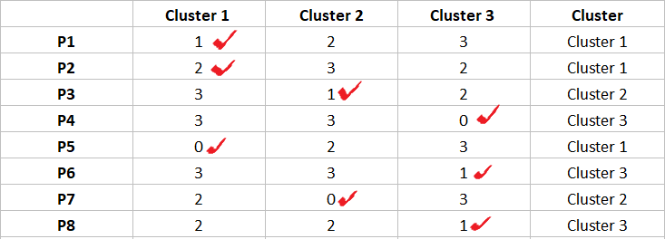
K-modes clustering Example(Cntd..)
We stop here as we see there is no change in the assignment of observations.

Slide 20
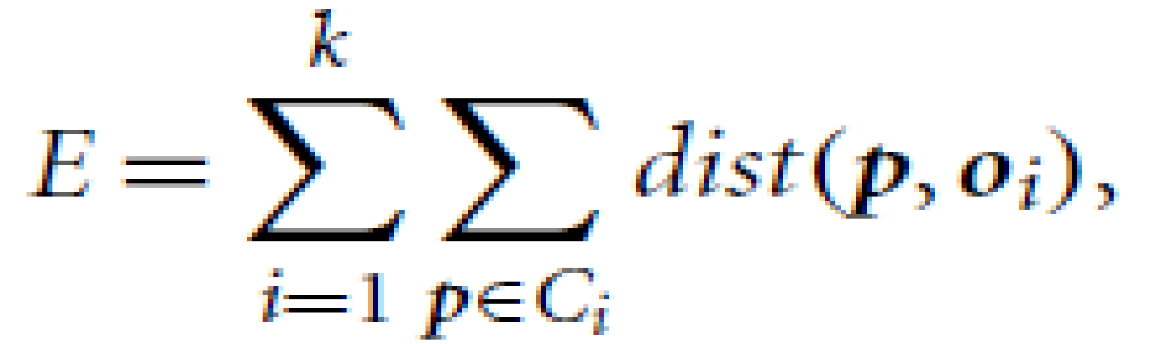
K-Medoids Algorithm
K-Medoids: Instead of taking the mean value of the objects in a cluster as a reference point, we can pick actual objects to represent the clusters, using one representative object per cluster(Medoid).
Each remaining object is assigned to the cluster of which the representative object is the most similar.
The partitioning method is then performed based on the principle of minimizing the sum of the dissimilarities between each object p and its corresponding representative object.
An absolute-error criterion is defined as
where E is the sum of the absolute error for all objects p in the data set, and oi is the representative object of Ci .
This is the basis for the k-medoids method, which groups n objects into k clusters by minimizing the absolute error
*
‹#›

Slide 21
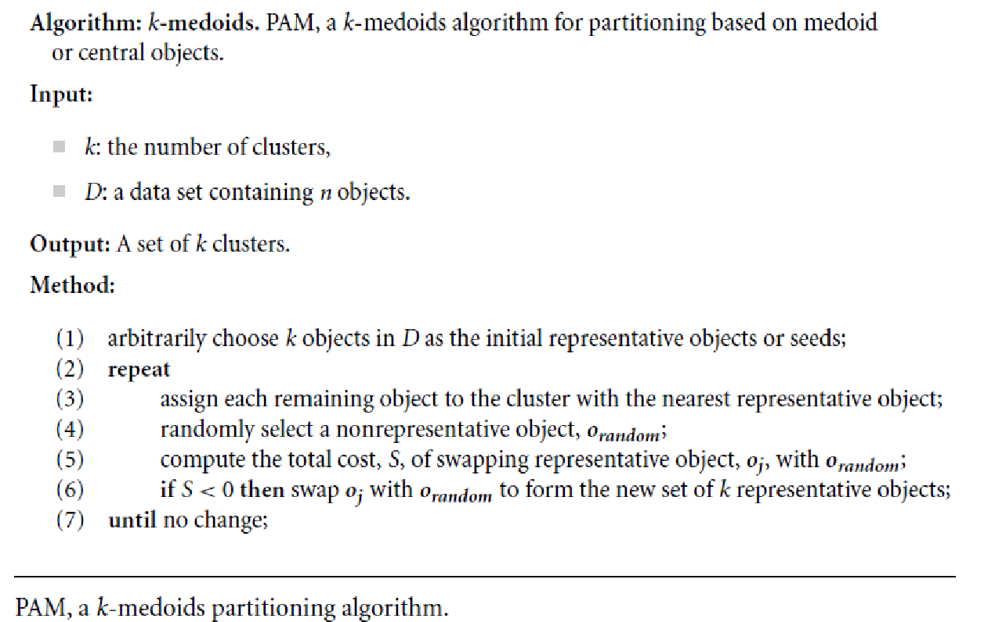
K-medoids,PAM
A medoid of a finite dataset is a data point from this set, whose average dissimilarity to all the data points is minimal i.e. it is the most centrally located point in the set.

Slide 22
Example: K-medoids,PAM
Given D={1,2,6,7,8,10,15,17,20} Form 3 clusters using k-medoid algorithm.
Assume initial medoids as 6,7 8 respectively for K1,K2,and K3.

Slide 23
What Is the Problem with PAM?
Adv: PAM is more robust than k-means in the presence of noise and outliers because a medoid is less influenced by outliers or other extreme values than a mean
Disadv:PAM works efficiently for small data sets but does not scale well for large data sets.
O(k(n-k)² ) for each iteration : very costly computation for large n and k where n is # of data objects and ,k is # of clusters
To deal with large data sets,a sampling based method called CLARA can be used.
*
Data Mining: Concepts and Techniques
‹#›

Slide 24
CLARA
CLARA (Clustering Large Applications,is an extension to k-medoids (PAM) methods to deal with data containing a large number of objects (more than several thousand observations) in order to reduce computing time and RAM storage problem. This is achieved using the sampling approach.
Instead of finding medoids for the entire data set, CLARA considers a small sample of the data with fixed size (sampsize) and applies the PAM algorithm to generate an optimal set of medoids for the sample.
The quality of resulting medoids is measured by the average dissimilarity between every object in the entire data set and the medoid of its cluster, defined as the cost function.
CLARA repeats the sampling and clustering processes for a pre-specified number of times in order to minimize the sampling bias. The final clustering results correspond to the set of medoids with the minimal cost.
*
‹#›

Slide 25
CLARA Algorithm
Create randomly, from the original dataset, multiple subsets with fixed size (sampsize)
Compute PAM algorithm on each subset and choose the corresponding k representative objects (medoids). Assign each observation of the entire data set to the closest medoid.
Calculate the mean (or the sum) of the dissimilarities of the observations to their closest medoid. This is used as a measure of the goodness of the clustering.
Retain the sub-dataset for which the mean (or sum) is minimal. A further analysis is carried out on the final partition.

Slide 26
CLARA
The complexity of computing the medoids on a random sample is O(ks² +k.(n-k)), where s is the size of the sample, k is the number of clusters, and n is the total number of objects.
The effectiveness of CLARA depends on the sample size.
If an object is one of the best k-medoids but is not selected during sampling, CLARA will never find the best clustering.(Example to demonstrate the same)
*
‹#›

Slide 27
CLARANS
A randomized algorithm called CLARANS (Clustering Large Applications based upon RANdomized Search) presents a trade-off between the cost and the effectiveness of using samples to obtain clustering.
*
‹#›

Slide 28
Steps of CLARANS algorithm
Select ‘k’ random data points and label them as medoids for the time being.
Select a random point say ‘a’ from the points picked in step (1), and another point say ‘b’ which is not included in those points.
We would already have the sum of distances of point ‘a’ from all other points since that computation is required for selecting the points in step (1). Perform similar computation for point ‘b’.
If the sum of distances from all other points for point ‘b’ turns out to be less than that for point ‘a’, replace ‘a’ by ‘b’.
The algorithm performs such a randomized search of medoids ‘x’ times where ‘x’ denotes the number of local minima computed, i.e. number of iterations to be performed, which we specify as a parameter. The set of medoids obtained after such ‘x’ number of steps is termed as ‘local optimum’.
A counter is incremented every time a replacement of points is made. The process of examining the points for possible replacement is repeated till the counter does not exceed the maximum number of neighbors to be examined (specified as a parameter).
The set of medoids obtained when the algorithm stops is the best local optimum choice of medoids.

Slide 29
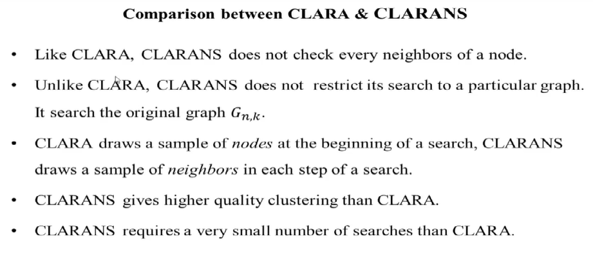

Slide 30
Hierarchical Clustering
A hierarchical clustering method works by partitioning data objects into groups at different levels like a hierarchy or “tree” of clusters.
Representing data objects in the form of a hierarchy is useful for data summarization and visualization.
If necessary, hierarchical partitioning can be continued recursively until a desired granularity is reached.
*
‹#›

Slide 31
Hierarchical Clustering (Agglomerative versus Divisive Hierarchical Clustering)
A hierarchical clustering method can be either agglomerative or divisive, depending on whether the hierarchical decomposition is formed in a bottom-up (merging) or top-down (splitting) fashion.
An agglomerative hierarchical clustering method :
The hierarchical decomposition is formed in a bottom-up (merging)way
A divisive hierarchical clustering method
The hierarchical decomposition is formed in a top-down (splitting)way
In either agglomerative or divisive hierarchical clustering, a user can specify the desired number of clusters as a termination condition.
Hierarchical methods suffer from the fact that once a step (merge or split) is done, it can never be undone. So these techniques cannot correct erroneous decisions.
‹#›

Slide 32
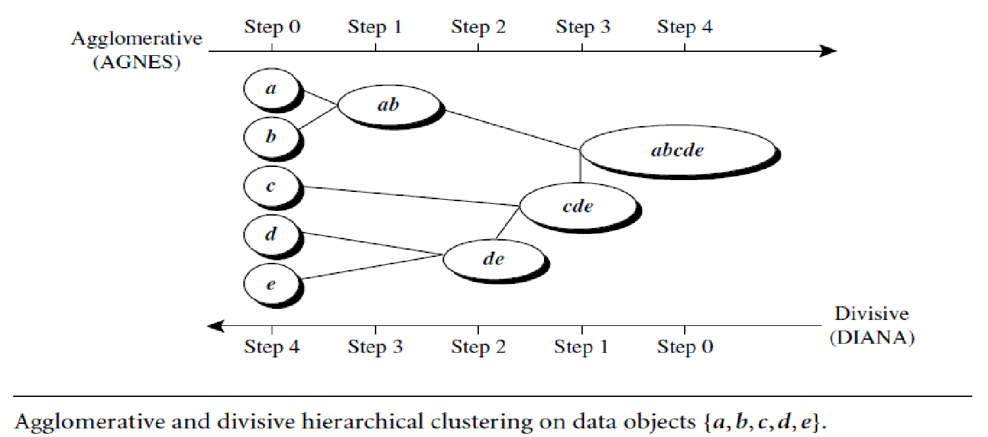
Example : Application of AGNES(AGglomerative NESting and DIANA(DIvisible ANAlysis)
*
‹#›

Slide 33
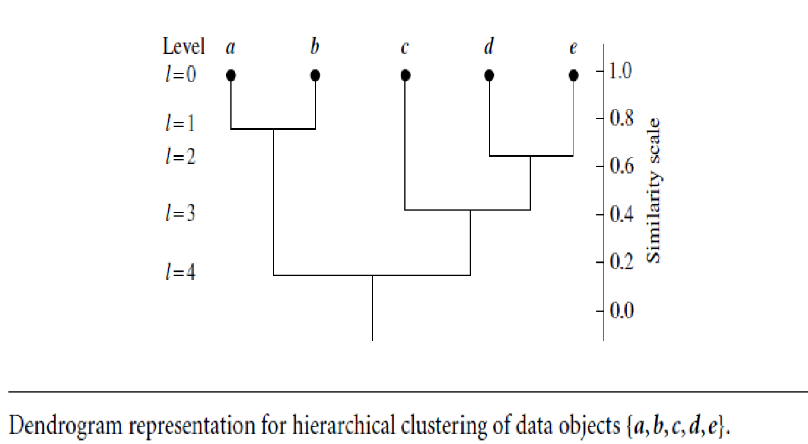
Hierarchical Clustering: Dendrogram

Slide 34
Divisive Method Challenges
How to partition a large cluster into smaller ones is a challenge.
– (2^{n-1}-1) ways to partition n objects into 2 exclusive clusters.
– For large n, it is computationally inhibitive to examine all possibilities .
Also a Divisive method typically uses heuristics in partitioning which can lead to inaccurate results.
For the sake of efficiency divisive methods typically do not backtrack on the partitioning decisions that have been made.
Due to these challenges, Agglomerative clustering is mostly used than divisive clustering.
*
‹#›

Slide 35
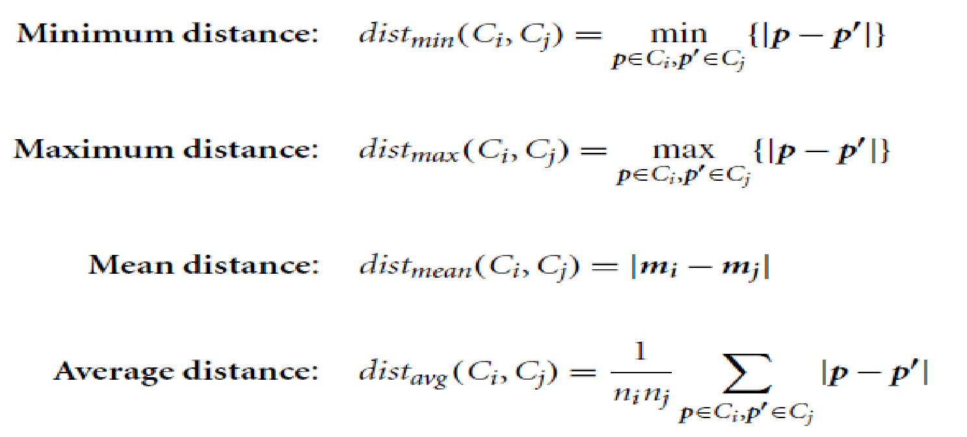
Distance Measures(linkage measures) in Agglomerative Method
|p-p’ | is the distance between two objects or points, p and p’;
mi is the mean for cluster, Ci ;
ni is the number of objects in Ci .
*
‹#›

Slide 36
Distance Measures(linkage measures) in Algorithmic Methods
When an algorithm uses the minimum distance, d_{min}(Ci ,Cj), to measure the distance between clusters, it is sometimes called a nearest-neighbor clustering algorithm.
Here if the clustering process is terminated when the minimum distance between nearest clusters exceeds a user-defined threshold, it is called a single-linkage algorithm.
When an algorithm uses the maximum distance, d_{max}(Ci ,Cj), to measure the distance between clusters, it is sometimes called a farthest-neighbor clustering algorithm.
Here,If the clustering process is terminated when the maximum distance between nearest clusters exceeds a user-defined threshold, it is called a complete-linkage algorithm
*
‹#›

Slide 37
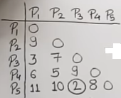
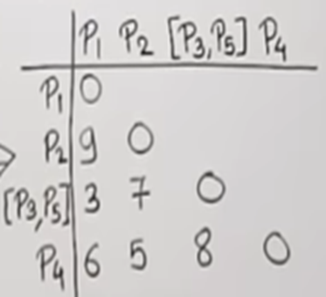
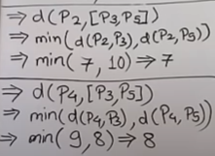
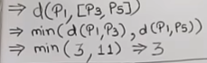
Example: Agglomerative Clustering (Single Linkage)
As 3 is minimum , combine [P3.P5] and [P1]

Slide 38
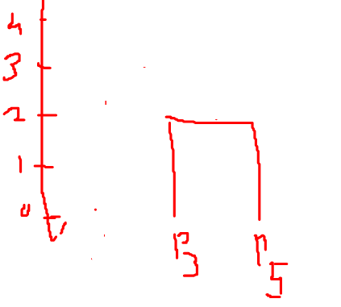
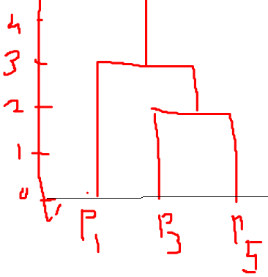
Dendrogram
Step 1
Step 2

Slide 39
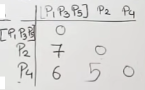
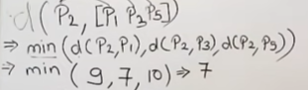
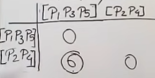
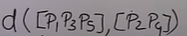
Combine [P2] and [P4]
combine [P1,P3.P5] and [P2,P4]into one cluster

Slide 40
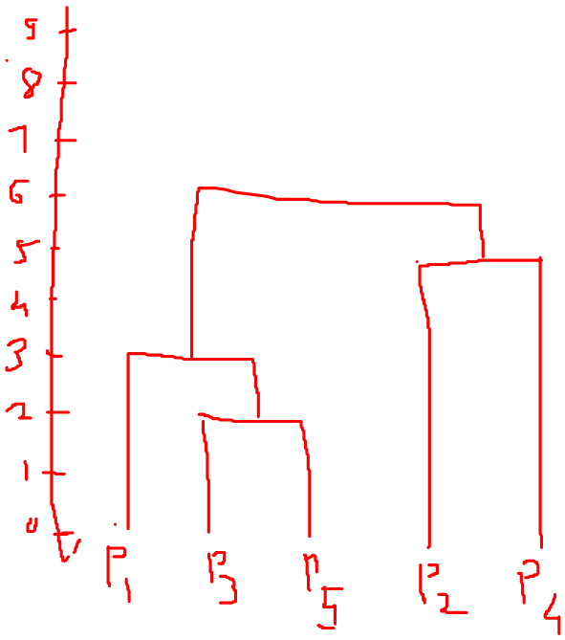
Dendrogram for the Example

Slide 41
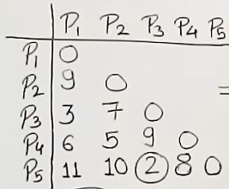
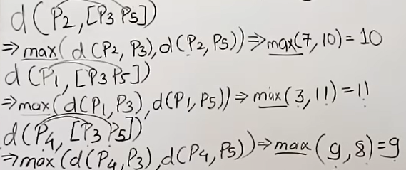
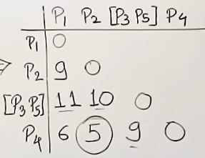
Complete Linkage
Combine [P3] and [P5]
Combine [P4] and [P2]

Slide 42
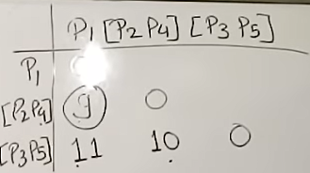
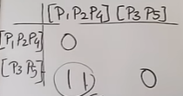
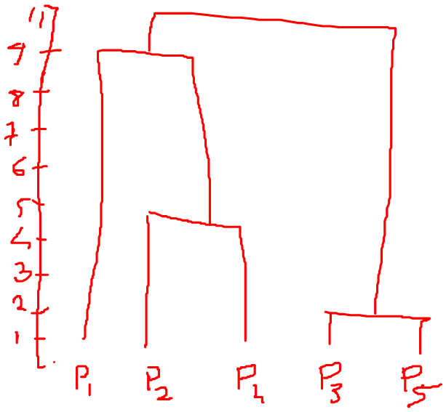
Agglomerative Clustering(Complete Linkage)
Combine [P2,P4] and [P1]
Combine [P1,P2,P4] and [P3.P5 to form a single cluster
Dendogram

Slide 43
BIRCH (1996)
Balanced Iterative Reducing and Clustering using Hierarchies (BIRCH) is designed for clustering a large amount of numeric data by integrating hierarchical clustering (at the initial microclustering stage) and other clustering methods such as iterative partitioning (at the later macroclustering stage).
Small summary of large dataset.
It overcomes the two difficulties in agglomerative clustering methods: (1) scalability and (2) the inability to undo what was done in the previous step.
BIRCH uses the notions of clustering feature to summarize a cluster, and clustering feature tree (CF-tree) to represent a cluster hierarchy.
These structures help the clustering method to achieve good speed and scalability in large DS and also make it effective for incremental and dynamic clustering of incoming data objects.
*
Data Mining: Concepts and Techniques
‹#›

Slide 44
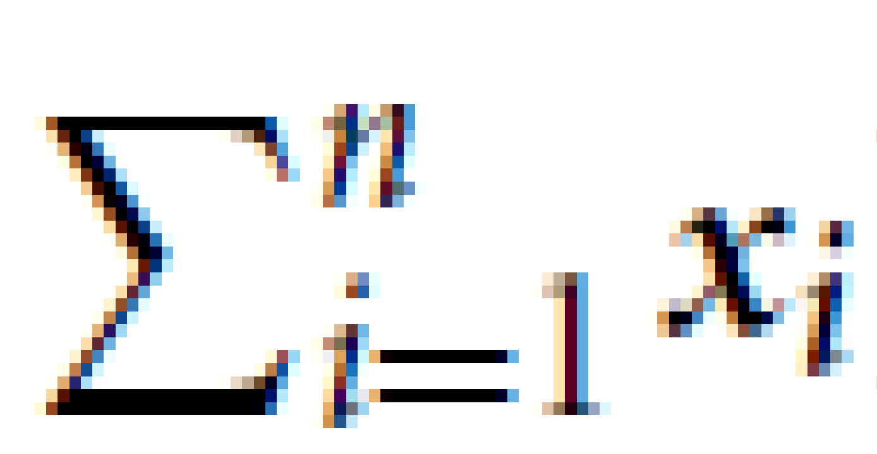
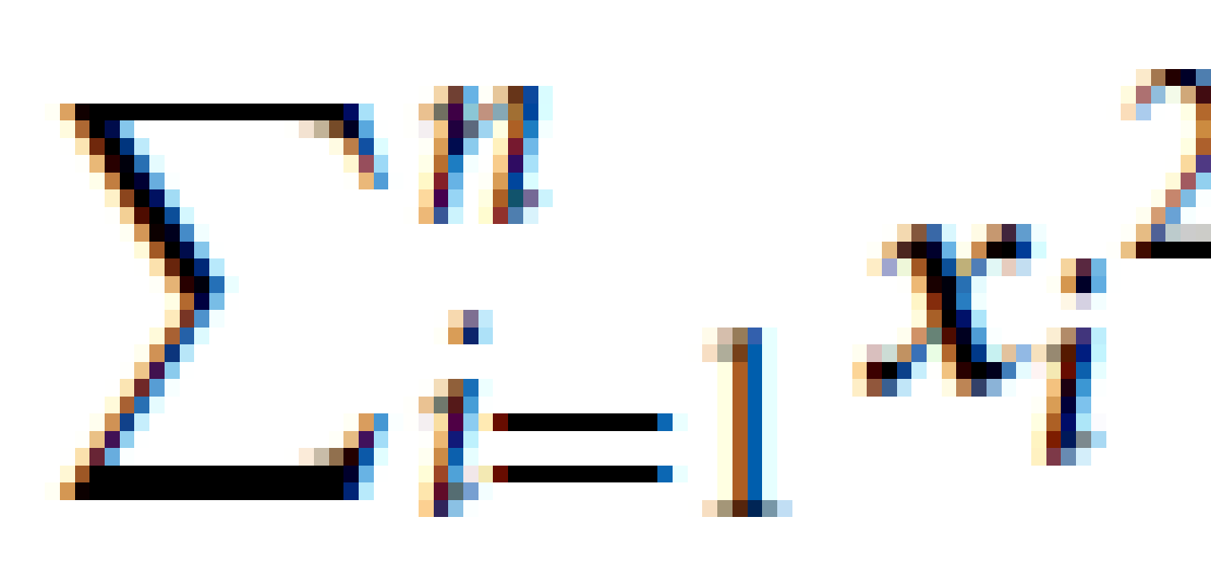
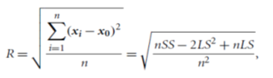
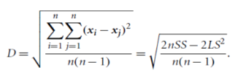
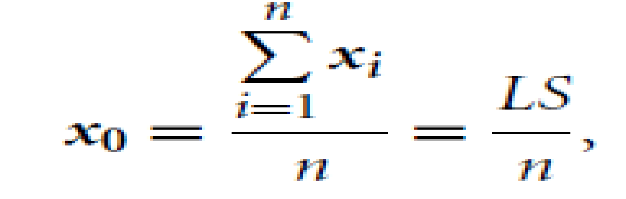
BIRCH (1996)
A clustering feature is essentially a summary of the statistics for the given cluster.
The clustering feature (CF) of the cluster is a 3-D vector summarizing information about clusters of objects.
CF =(n,LS,SS) where
LS is the linear sum of the n points i.e.,
SS is the square sum of the data points i.e.,
Using a clustering feature, we can easily derive many useful statistics of a cluster.
For example, the cluster’s centroid, x0, radius, R, and diameter, D, are
Here, R is the average distance from member objects to the centroid, and D is the average pairwise distance within a cluster
*
‹#›

Slide 45
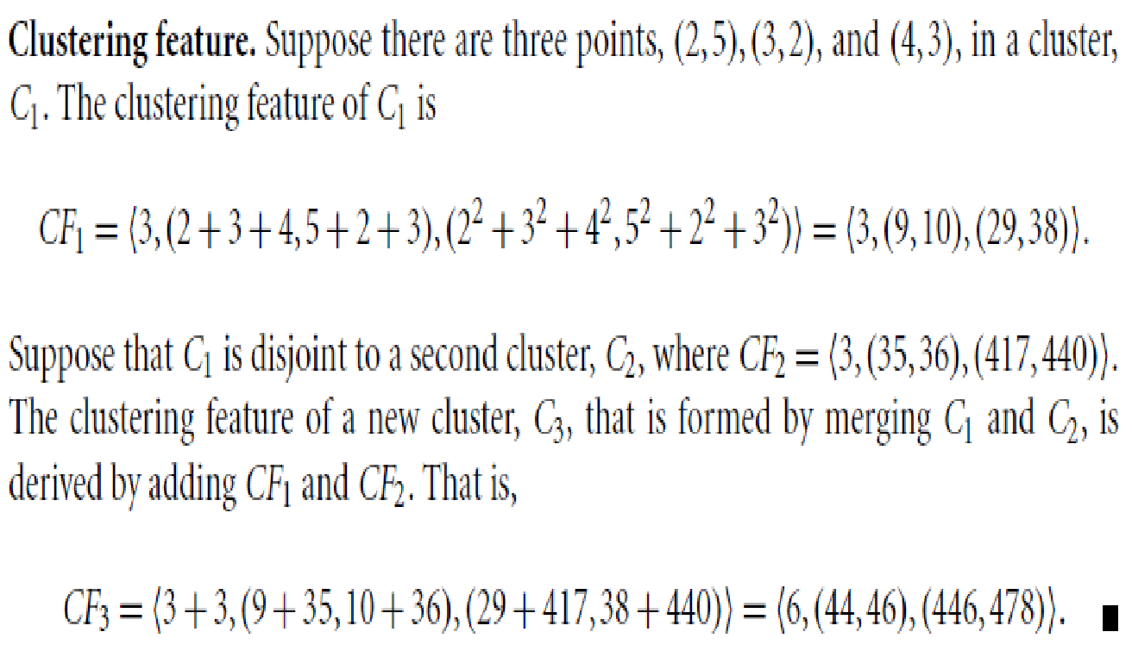
Example

Slide 46
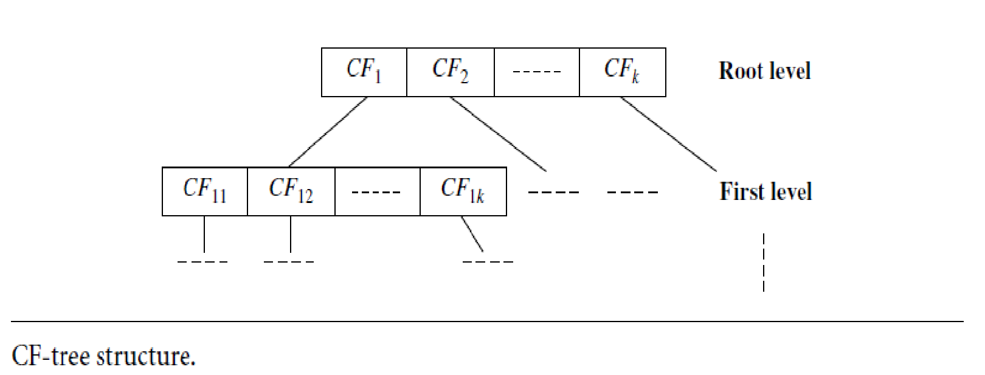
Clustering Feature Tree (CF Tree)
A CF-tree is a height-balanced tree that stores the clustering features for a hierarchical clustering.
A CF-tree has two parameters:
Branching factor, B, specifies the maximum number of children per nonleaf node.
The threshold parameter T, specifies the maximum diameter of subclusters stored at the leaf nodes of the tree.
These two parameters implicitly control the resulting tree’s size.
Each nonleaf node stores sum of CFs of its children

Slide 47
Clustering Feature Tree (CF Tree)
BIRCH applies a multiphase clustering technique:
The primary phases are
Phase 1: BIRCH scans the database to build an initial in-memory CF-tree, which can be viewed as a multilevel compression of the data that tries to preserve the data’s inherent clustering structure.
Phase 2: BIRCH applies a (selected) clustering algorithm to cluster the leaf nodes of the CF-tree, which removes sparse clusters as outliers and groups dense clusters into larger ones.

Slide 48
Clustering Feature Tree (CF Treee)
“How effective is BIRCH?”
The time complexity of the algorithm is O(n), where n is the number of objects to be clustered.
Experiments have shown the linear scalability of the algorithm with respect to the number of objects, and good quality of clustering of the data.
Drawbacks:
Since each node in a CF-tree can hold only a limited number of entries due to its size,a CF-tree node does not always correspond to what a user may consider a natural cluster.
Moreover, if the clusters are not spherical in shape, BIRCH does not perform well because it uses the notion of radius or diameter to control the boundary of a cluster.
It can process only the metric attributes.
Implementation of BIRCH in Python: Link

Slide 49
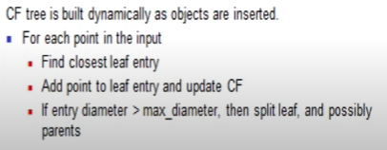

Slide 50
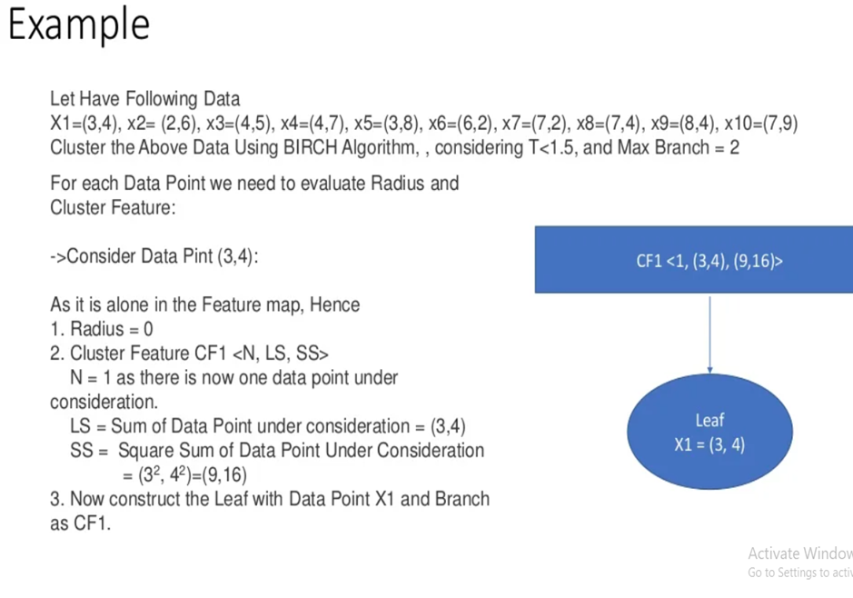

Slide 51
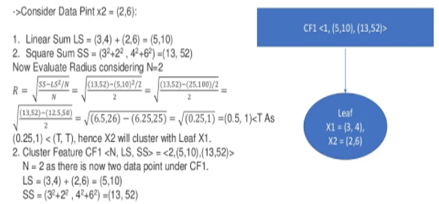

Slide 52
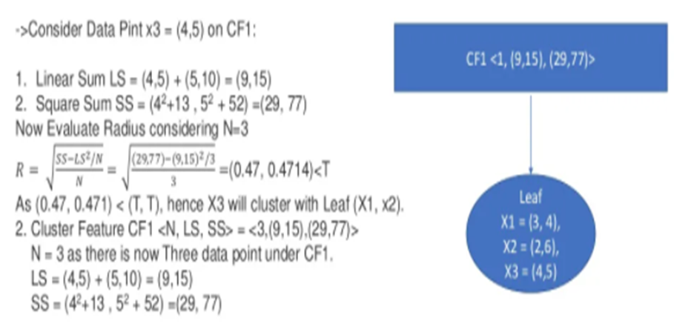

Slide 53
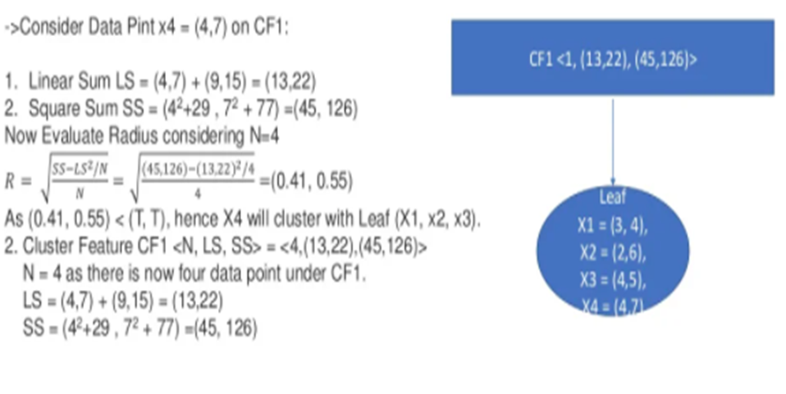

Slide 54
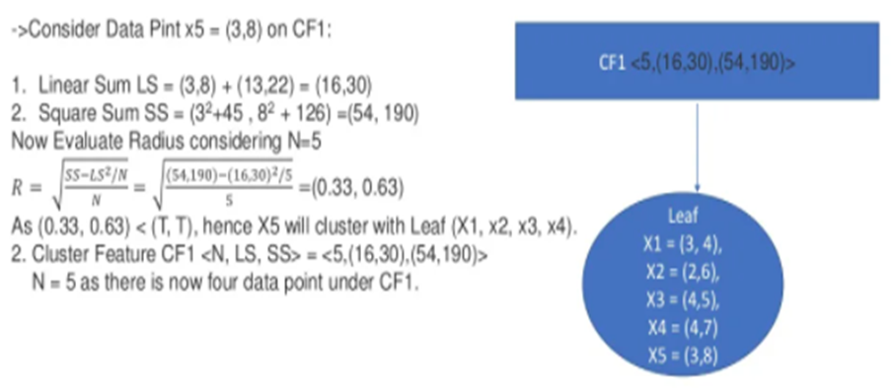

Slide 55
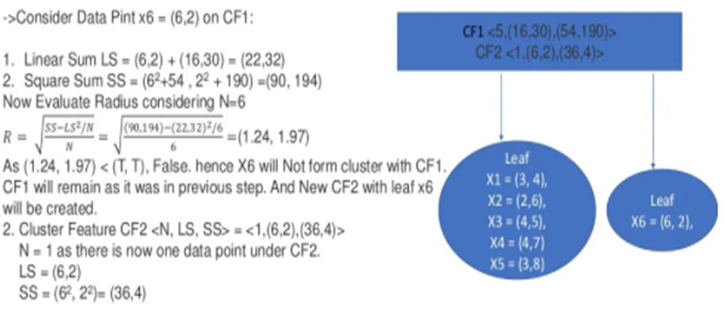

Slide 56
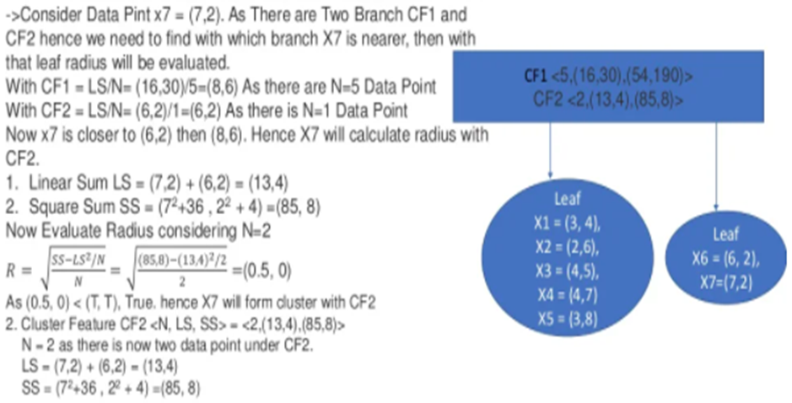


Slide 57
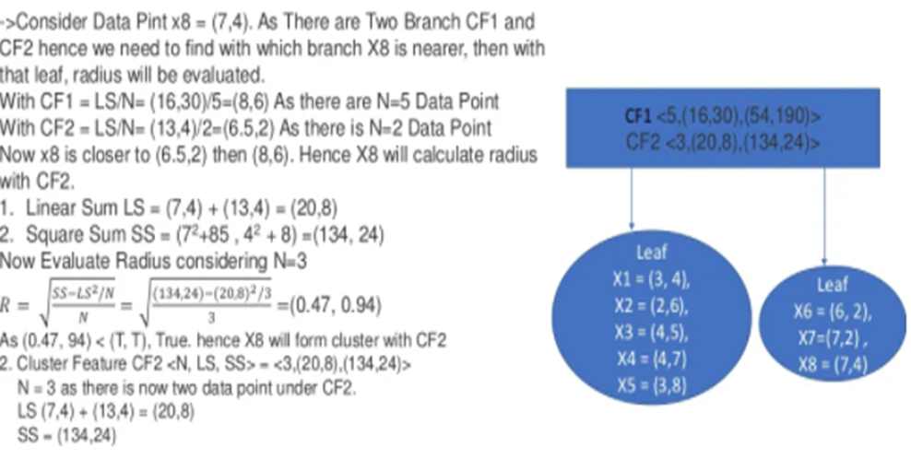

Slide 58
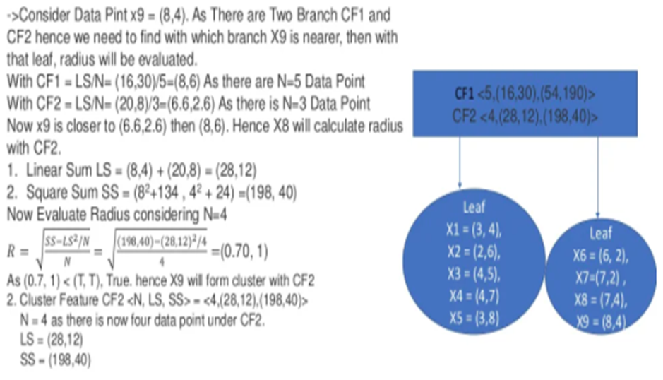

Slide 59


Slide 60
Density Based Clustering
Density-based approach:
Based on connectivity and density functions.
The strategy used is to model the dense clusters separated by sparse clusters.
The general idea is to continue growing a given cluster as long as the density (number of objects or data points) in the “neighborhood” exceeds some threshold.
Such a method can be used to filter out noise or outliers and discover clusters of arbitrary shape.
Major features:
Discover clusters of arbitrary shape
Handle noise
One scan
Need density parameters as termination condition
Typical methods: DBSCAN, OPTICS, DenClue
*
Data Mining: Concepts and Techniques
‹#›

Slide 61
DBSCAN(Density Based Spatial Clustering of Application with Noise
Density-Based Clustering Algorithm Based on Connected Regions with High Density.
The key idea is that for each point of a cluster, the neighborhood of a given radius has to contain at least a minimum number of points.
Why DBSCAN?
Real life data may contain irregularities, like:
Clusters can be of arbitrary shape.
Data may contain noise.
*
Data Mining: Concepts and Techniques
‹#›

Slide 62
DBSCAN
DBSCAN algorithm requires two parameters:
eps : It defines the neighborhood around a data point
if the distance between two points is <= ‘eps’ then they are considered as neighbors.
If the eps value is chosen too small then large part of the data will be considered as outliers.
If it is chosen very large then the clusters will merge and majority of the data points will be in the same clusters.
One way to find the eps value is based on the k-distance graph.
MinPts: Minimum number of neighbors (data points) within eps radius.
Larger the dataset, the larger value of MinPts must be chosen.
As a general rule, the minimum MinPts can be derived from the number of dimensions D in the dataset as, MinPts >= D+1.
The minimum value of MinPts must be chosen as at least 3.
*
Data Mining: Concepts and Techniques
‹#›

Slide 63
DBSCAN: Density-Based Clustering Based on Connected Regions with High Density
“How can we find dense regions in density-based clustering?”
The density of an object o can be measured by the number of objects close to o.
DBSCAN (Density-Based Spatial Clustering of Applications with Noise) finds core objects, that is, objects that have dense neighborhoods. It connects core objects and their neighborhoods to form dense regions as clusters.
*
‹#›

Slide 64


DBSCAN
In this algorithm, we have 3 types of data points.
Core Point: A point is a core point if it has more than MinPts points within eps.
Border Point: A point which has fewer than MinPts within eps(i.e it is not a core point ) but it is in the neighborhood of a core point.
Noise or outlier: A point which is not a core point or border point.
MinPts=3
*
‹#›

Slide 65
Density-Based Clustering: Basic Concepts
Two parameters:
Eps : Maximum radius of the neighborhood
MinPts : Minimum number of points in an Eps-neighbourhood of that point
N_{Eps}(p): {q belongs to D | dist(p,q) <= Eps}
Directly density-reachable: A point p is directly density-reachable from a point q w.r.t. Eps, MinPts if
p belongs to N_{Eps}(q)
core point condition:
|N_{Eps} (q)| >= MinPts
p
MinPts = 5
Eps = 1 cm
q
*
Data Mining: Concepts and Techniques
‹#›

Slide 66
Density-Reachable and Density-Connected
Density-reachable:
A point p is density-reachable from a point q w.r.t. Eps, MinPts if there is a chain of points p₁, …, p_{n}, p₁ = q, p_{n} = p such that p_{i+1} is directly density-reachable from p_{i}
Density-connected
A point p is density-connected to a point q w.r.t. Eps, MinPts if there is a point o such that both, p and q are density-reachable from o w.r.t. Eps and MinPts
p
p₁
q
p
q
o
*
Data Mining: Concepts and Techniques
‹#›

Slide 67
DBSCAN: The Algorithm
Arbitrarily select a point p
Retrieve all points that are density-reachable from p w.r.t. Eps and MinPts.
If p is a core point, a cluster is formed.
If p is a border point, no points are density-reachable from p and DBSCAN visits the next point of the database.
Continue the process until all of the points have been processed.
*
‹#›

Slide 68

DBSCAN Algorithm

Slide 69



DBSCAN: Sensitive to Parameters
*
Data Mining: Concepts and Techniques
‹#›

Slide 70


Example: DBSCAN
Find clusters using DBSCAN
Є =2, MinPts=2
Step1 : Find distance matrix

Slide 71
Example: DBSCAN
Step2 : Find which data points are core points
Є =2, MinPts=2
Cluster1={A3,A5,A6}
Cluster2={A4,A8}
A1,A2,A7 are outliers
A1
A2
A3,A5,A6
A3,A5,A6
A4,A8
Є-neighborhood
A1
A4,A8
A3,A5,A6
A7
Є-neighborhood
The no. of data points in the Є-neighbourhood of A1= 1(A1 itself) . < MinPts . Hence A1 is not a core point

Slide 72

Example: DBSCAN
Find clusters using DBSCAN
Є =2, MinPts=3
Find which data points are core points, Boundary points and Outliers.

Slide 73
Example: DBSCAN
Find clusters using DBSCAN
Є =2, MinPts=3
C,E
A,B
C,E
D,E,F
A,B
A,B
Є-neighborhood
A,B
D,E,F
C,D,E,F
Find which data points are core points, Boundary Points and Outliers
D,E and F are core points.
A and B are outliers
C is Boundary point as it is in Є-neighborhood of core point E

Slide 74
Self Learning
Hierarchical methods :
Chameleon, Density based methods: OPTICS,
Grid based methods: STING, CLIQUE

Slide 75
Suppose that the data mining task is to cluster points (with (x, y) representing location) into three clusters, where the points are A1(2, 10),A2(2, 5),A3(8, 4),B1(5, 8),B2(7, 5),B3(6, 4),C1(1, 2),C2(4, 9). The distance function is Euclidean distance. Suppose initially we assign A1, B1, and C1 as the center of each cluster, respectively. Use the k-means algorithm to show only
(a) the three cluster centers after the first round of execution.
Answer:
After the first round, the three new clusters are: (1) {A1}, (2) {B1,A3,B2,B3,C2}, (3) {C1,A2}, and their centers are (1) (2, 10), (2) (6, 6), (3) (1.5, 3.5).
(b) the final three clusters.
Answer:
The final three clusters are: (1) {A1,C2,B1}, (2) {A3,B2,B3}, (3) {C1,A2}.

Slide 76
Use an example to show why the k-means algorithm may not find the global optimum, that is, optimizing the within-cluster variation.
Answer:
Consider applying the k-means algorithm on the following points, and set k = 2. A(0, 1), B(0,−1), Ci(100, 50) (i = 1, . . . , 100), and Dj(100,−50) (j = 1, . . . , 100).
If we use A and C1 as the initial cluster centers, then the clustering process will converge to two centers, (0, 0) and (100, 0).
The within-cluster variation is
E = 12 + 12 + 100 × 502 + 100 × 502 = 1 + 1 + 100 × 2500 + 100 × 2500 = 500002.
However, if we use (100, 50) and (100,−50) as the cluster centers, the within-cluster variation is
E = (1002 + 492) + (1002 + 492) + 100 × 0 + 100 × 0 = 24802,
which is much smaller. This example shows k-means may be trapped by a local optimal, and cannot jump out to find the global optimum

Slide 77
Both k-means and k-medoids algorithms can perform effective clustering.
(a) Illustrate the strength and weakness of k-means in comparison with the k-medoids algorithm.
Answer:
k-means vs. k medoids: more efficient but quality deteriorates by noise and outliers.
b) Illustrate the strength and weakness of these schemes in comparison with a hierarchical clustering scheme (such as AGNES).
Answer:
Partition: can undo what was done (by moving objects around clusters)—quality is good in general, require the number of clusters to be known; find only spherical shaped clusters.
Hierarchical: cannot undo what was done—quality could be poor, does not require the number of clusters to be known; more efficient and parallel (divide and conquer), may find only arbitrary shaped clusters.

Slide 78
Present conditions under which density-based clustering is more suitable than partitioning-based clustering and hierarchical clustering. Give application examples to support your argument.
Answer:
Density-based clustering is more suitable if no or very limited domain knowledge is available to determine the appropriate values of the parameters, the clusters are expect of arbitrary shape including non convex shapes, and the efficiency is essential on large data sets.
For example, consider the application of recognizing residential area on a map where buildings and their types are labeled. A user may not have the domain knowledge about how a residential area would look like. Moreover, a residential area may be of arbitrary shape, and may not be in convex, such as those built along a river. In a large city, there are hundreds of thousands of buildings. Efficiency on large data sets is important.

Slide 79
Give an example of how specific clustering methods can be integrated, for example, where one clustering algorithm is used as a preprocessing step for another. In addition, provide reasoning as to why the integration of two methods may sometimes lead to improved clustering quality and efficiency.
Answer:
Consider building an ontology of queries for information retrieval and web search. A query is associated with a vector of web pages that are clicked when the query is asked. An effective approach is to first conduct density-based clustering to form small clusters as micro-clusters.
Each micro-cluster is treated as a base unit, sometimes called a concept. Then, a hierarchical clustering method can be applied to build an ontology.
To use density-based clustering as a pre-processing step can quickly merge synonyms, such as “University of Illinois at Urbana-Champaign” and “UIUC”, into one concept. This preprocessing step can reduce the data so that the ontology built later is more meaningful, and the ontology building process is faster.

Slide 80
What Is Outlier Discovery?
What are outliers?
The set of objects are considerably dissimilar from the remainder of the data
Example: Sports: Michael Jordon, Wayne Gretzky, ...
Problem: Define and find outliers in large data sets
Applications:
Credit card fraud detection
Telecom fraud detection
Customer segmentation
Medical analysis
*
Data Mining: Concepts and Techniques
‹#›

Slide 81

Outlier Discovery: Statistical Approaches
Assume a model underlying distribution that generates data set (e.g. normal distribution)
Use discordancy tests depending on
data distribution
distribution parameter (e.g., mean, variance)
number of expected outliers
Drawbacks
most tests are for single attribute
In many cases, data distribution may not be known
*
Data Mining: Concepts and Techniques
‹#›

Slide 82
Outlier Discovery: Distance-Based Approach
Introduced to counter the main limitations imposed by statistical methods
We need multi-dimensional analysis without knowing data distribution
Distance-based outlier: A DB(p, D)-outlier is an object O in a dataset T such that at least a fraction p of the objects in T lies at a distance greater than D from O
Algorithms for mining distance-based outliers
Index-based algorithm
Nested-loop algorithm
Cell-based algorithm
*
Data Mining: Concepts and Techniques
‹#›

Slide 83

Density-Based Local Outlier Detection
Distance-based outlier detection is based on global distance distribution
It encounters difficulties to identify outliers if data is not uniformly distributed
Ex. C₁ contains 400 loosely distributed points, C₂ has 100 tightly condensed points, 2 outlier points o₁, o₂
Distance-based method cannot identify o₂ as an outlier
Need the concept of local outlier
Local outlier factor (LOF)
Assume outlier is not crisp
Each point has a LOF
*
Data Mining: Concepts and Techniques
‹#›

Slide 84
Outlier Discovery: Deviation-Based Approach
Identifies outliers by examining the main characteristics of objects in a group
Objects that “deviate” from this description are considered outliers
Sequential exception technique
simulates the way in which humans can distinguish unusual objects from among a series of supposedly like objects
OLAP data cube technique
uses data cubes to identify regions of anomalies in large multidimensional data
*
Data Mining: Concepts and Techniques
‹#›

Slide 85
Problems and Challenges
Considerable progress has been made in scalable clustering methods
Partitioning: k-means, k-medoids
Hierarchical: AGNES, DIANA, BIRCH,
Density-based: DBSCAN,
Current clustering techniques do not address all the requirements adequately, still an active area of research
*
Data Mining: Concepts and Techniques
‹#›

